Slide 1


<Name>
<Date>

Slide 2

Outline
Executive Summary
Introduction
Methodology
Results
Conclusion
Appendix

Slide 3
Executive Summary
Summary of methodologies
Data collection using web scraping and APIs
Data wrangling
EDA using SQL and data visualizations
Machine learning to create predictions
Summary of all results
Data can be collected from the web and other public sources
EDA can be used to form insights into which features might be good predictors of launching success
Machine learning can be employed to predict the success of a launch

Slide 4
Introduction
Project background and context
SpaceX outperforms its competitors at launching rockets on a cost basis significantly. This is because SpaceX can reuse launchers. Not all of these launches are fully successful however. This project is meant to use machine learning to predict which launches will be successful, and which launches are expected to cost more.
Problems you want to find answers
What variables can be used to predict if a launch will be successful?
How to estimate the total cost for a launch based off of it’s predicted sucess

Slide 5

Section 1

Slide 6
Methodology
Executive Summary
Data collection methodology:
Data was retrieved from a SpaceX API and Wikipedia
Perform data wrangling
Data was cleaned and categorical features were processed using dummy encoding
Perform exploratory data analysis (EDA) using visualization and SQL
Perform interactive visual analytics using Folium and Plotly Dash
Perform predictive analysis using classification models
How to build, tune, evaluate classification models

Slide 7
Data Collection
Describe how data sets were collected.
The first set of data was by using a GET request from the SpaceX API. The data was turned into an object and then put into a Pandas dataframe
The second set of data was acquired using web scraping from Wikipedia using BeautifulSoup. This data was created as an HTML table converted into a Pandas dataframe
The data was checked and cleaned, with the missing values being filled as necessary

Slide 8

Data Collection – SpaceX API
GET request was used to acquire the SpaceX API data
Source Code: https://github.com/gfoltz/IBM-Data-Science-Capstone-SpaceX/blob/main/Data%20Collection%20API.ipynb.

Slide 9

Data Collection - Scraping
Data was scraped from Wikipedia and BeautifulSoup was used to turn the object into an HTML and then it was converted into a Pandas DF
Source Code: https://github.com/gfoltz/IBM-Data-Science-Capstone-SpaceX/blob/main/Data%20Collection%20with%20Web%20Scraping.ipynb.

Slide 10
Data Wrangling
After exploratory data analysis we were able to create a landing outcome label and created a .csv file to house the data
Source Code: https://github.com/gfoltz/IBM-Data-Science-Capstone-SpaceX/blob/main/Data%20Wrangling.ipynb.

Slide 11

EDA with Data Visualization
We created several charts to visualize the data. This was to try and find insights into the relationships between certain variables. One such viz is shown to the right which shows the success rate by orbit class
Source Code https://github.com/gfoltz/IBM-Data-Science-Capstone-SpaceX/blob/main/EDA%20with%20Data%20Visualization.ipynb

Slide 12
EDA with SQL
Additionally, we used SQL inside Jupyter Notebook to use queries to explore the data. Some queries we used included:
The distinct names of launch sites
Sum of payload mass carried
Top 5 launch sites
Total number of successful and unsuccessful outcomes
Launchpads with unsuccessful outcomes
Source Code: https://github.com/gfoltz/IBM-Data-Science-Capstone-SpaceX/blob/main/EDA%20with%20SQL.ipynb

Slide 13
Build an Interactive Map with Folium
We noted all launch sites and map objects such as markers, circles, lines, to visualize where successes and failures occurred. We assigned launch outcomes in binary with a 1 indicating success and 0 indicating a failure
Colored markers were used to show which launch sites are more likely to have a successful launch based off of historical data. We also noted the geography of launch sites, seeing that they were mostly away from cities and near coastlines.

Slide 14
Build a Dashboard with Plotly Dash
We also created an interactive dashboard using Plotly Dash that visualized the percentage of launches by site and the relationship between payload mass and outcomes in order to try to identify which variables were related to the outcome of a launch
Source Code: https://github.com/gfoltz/IBM-Data-Science-Capstone-SpaceX/blob/main/app.py

Slide 15
Predictive Analysis (Classification)
We created 4 classifications models
Logistic regression
SVM
Decision Tree
KNN
We prepped the data and tested each model in order to compare the results between each model
Source Code: https://github.com/gfoltz/IBM-Data-Science-Capstone-SpaceX/blob/main/Machine%20Learning%20Prediction.ipynb

Slide 16
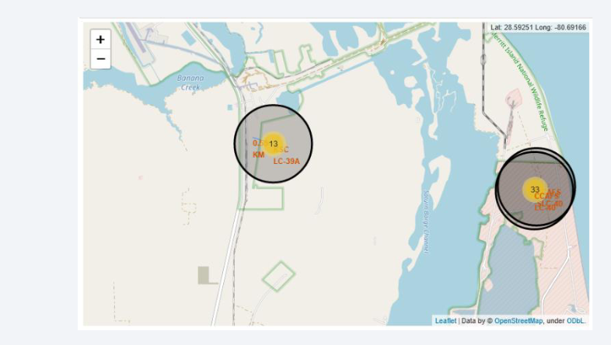
Results
Exploratory data analysis results
SpaceX uses 4 different launches, most launches are successful, and the number of successes has increased as time passed
Interactive analytics demo in screenshots
Most launch sites are coastal and have good infrastructure
Predictive analysis results
The decision tree was the best model at predicting

Slide 17

Section 2

Slide 18

Flight Number vs. Launch Site
General success rate improved as time went on, and the best launch site was in general CCAF5 SLC 40

Slide 19

Payload vs. Launch Site
Higher payloads tend to increase the success rate of a launch

Slide 20

Success Rate vs. Orbit Type
ES-L1, GEO, HEO, SSO, VLEO had the highest successes

Slide 21

Flight Number vs. Orbit Type
There doesn’t seem to be any strong correlation between flight # and orbit

Slide 22

Payload vs. Orbit Type
Larger payloads tend to correlate with more successful launches

Slide 23

Launch Success Yearly Trend
As time goes on, launches tend to be more successful

Slide 24

All Launch Site Names
Here are the list of launch sites. DISTINCT is used to only return unique values

Slide 25

Launch Site Names Begin with 'CCA'
Here are 5 launches where the launch begins with CCA

Slide 26

Total Payload Mass
Here is the total payload carried by boosters from NASA

Slide 27

Average Payload Mass by F9 v1.1
Here is the average payload mass from booster F9 v1.1

Slide 28

First Successful Ground Landing Date
The first success was on 12/22/2015

Slide 29

Successful Drone Ship Landing with Payload between 4000 and 6000
Here are the boosters that have a payload mass of between 4000 and 6000 that have had successful launches

Slide 30

Total Number of Successful and Failure Mission Outcomes
Here are the total number of successful and failed missions

Slide 31

Boosters Carried Maximum Payload
Here are the boosters that carried the maximum payload

Slide 32

2015 Launch Records
Here are the failed landing_outcomes in drone ship, their booster versions, and launch site names for in year 2015

Slide 33

Rank Landing Outcomes Between 2010-06-04 and 2017-03-20
Here is a rank of the count of landing outcomes between the date 2010-06-04 and 2017-03-20

Slide 34

Section 3

Slide 35

All launch sites
All launch sites are in the US, either in CA or FL

Slide 36
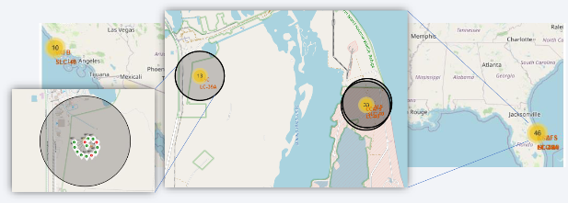
Launch outcomes by Site
Green markers are successes and red markers are unsuccessful in this example at Launch Site KSC LC 39A

Slide 37
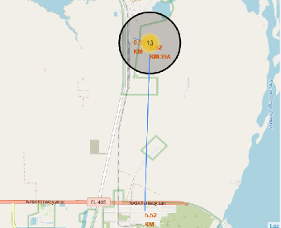
Logistics
This launch site is near a rail, road, and the coast. It is far from inhabited areas

Slide 38

Section 4

Slide 39

Successful launches by site
Replace <Dashboard screenshot 1> title with an appropriate title
Show the screenshot of launch success count for all sites, in a piechart
Explain the important elements and findings on the screenshot

Slide 40

Launch successes for KSC LC 39A

Slide 41

Payload vs Launch Outcome

Slide 42

Section 5

Slide 43

Classification Accuracy
The decision tree has the highest classification accuracy
Find which model has the highest classification accuracy

Slide 44

Confusion Matrix
This confusion matrix shows that the model is good at classifying true negatives, but has a bias towards classifying false positives

Slide 45
Conclusions
We can conclude that:
The larger the flight amount at a launch site, the greater the success rate at a launch site.
Launch success rate increase in 2013 till 2020.
Launches above 7000kg are less risky
The best launch site is KSC LC-39A
The Decision tree classifier was the most accurate machine learning tool

Slide 46


